Slide 1

RAJA BALWANT SINGH ENGINEERING TECHNICAL CAMPUS, BICHPURI, AGRA Department of Electronics and Communication
Topic:-
SMART PARKING MANGEMENT SYSTEM
Submitted To:-
Er. Thakurendra Singh
Submitted by:-
Anu Sharma (2000040310006)
Arzoo Goyal (2000040310008)
Payal Mohnani (2000040310032)

Slide 2
Introduction
Now-a-days one of the biggest problems is when we enter a parking area then we realize that there are no empty parking slots to park our cars. Sometimes, we all may have been facing these problems that waste our important resources like time.
The "SMART PARKING MANGEMENT SYSTEM" is a project provides us to deal with the problems discussed before.
Using this type of systems at heavy rush places gives us the convenience from congestions, unavoidable interrupts, wastage of time and facilitates comfort.

Slide 3
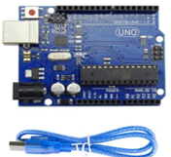
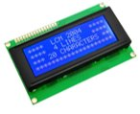
Components
Arduino UNO ​
The Arduino UNO R3 board includes the following specifications.​
It is an ATmega328P based Microcontroller.​
Digital input and output pins-14.​
The Operating Voltage of the Arduino is 5V.​
Analog I/P pins are 6.​
Digital input & output pins (PWM)-6​
Flash Memory: 32 KB of which 0.5 KB used by bootloader.
Power Sources: DC Power Jack & USB Port
20*4 LCD Display ​
It is a 20 character x 4 line Blue LCD.​
In this we have 4-bit and 8-bit parallel interface.​
It operates on 5V power supply.​
1x16 Male header strip through which use to connect with peripheral devices.​

Slide 4
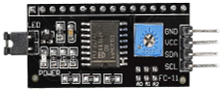
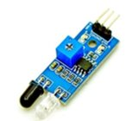
Continue...
I2C LCD Module ​
Adjustable backlight intensity and contrast 5V operation​.
I2C Module has a inbuilt I2C chip that converts I2C serial data to parallel data for the LCD display. ​
Where I2C stands for Inter-Integrated Circuit.​
It operates on 5V.​
IR Sensor module​
IR sensor consist of IR transmitter and receiver.​
An infrared sensor is an electronic device, that emits in order to sense some aspects of the surroundings.​
The operating voltage is 5VDC.​
I/O pins – 3.3V & 5V.​
The supply current is 20mA. ​
The range is up to 20 centimeter.​

Slide 5

Continue...
Mini Servo Motor SG-90
It is very small micro size.​
Can lift 3.75lb positioned 1cm from center of shaft.​
It have 180 degree rotation.​
Analog drive circuitry.​
It is low cost device.

Slide 6
Project Details
This “Smart parking management system” project consists of Arduino, six IR sensors, one servo motor, and one LCD display.
Where the Arduino is the main microcontroller that controls the whole system.
Two IR sensors are used at the entry and exit gates to detect vehicle entry and exit in the parking area. And other four IR sensors are used to detect the parking slot availability.
The servo motor is placed at the entry and exit gate that is used to open and close the gates.
Also, an LCD display is placed at the entrance, which is used to show the availability of parking slots in the parking area.

Slide 7
Continue…
When a vehicle arrives at the gate of the parking area, the display continuously
shows the number of empty slots.
If there have any empty slots then the system opens the entry gate by the servo
motor. After entering the car into the parking area, when it will occupy a slot,
then the display shows this slot is full.
If there is no empty parking slot then the system displays all slots are full and
does not open the gate.

Slide 8
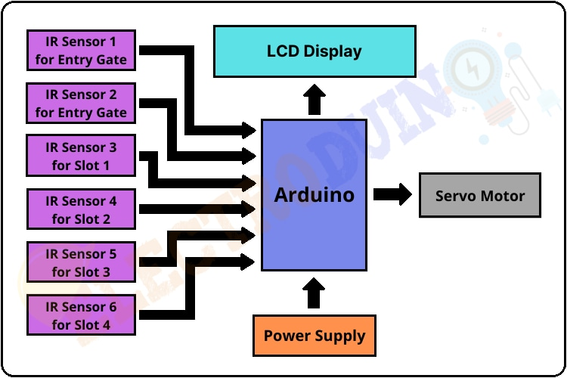
Block Diagram

Slide 9
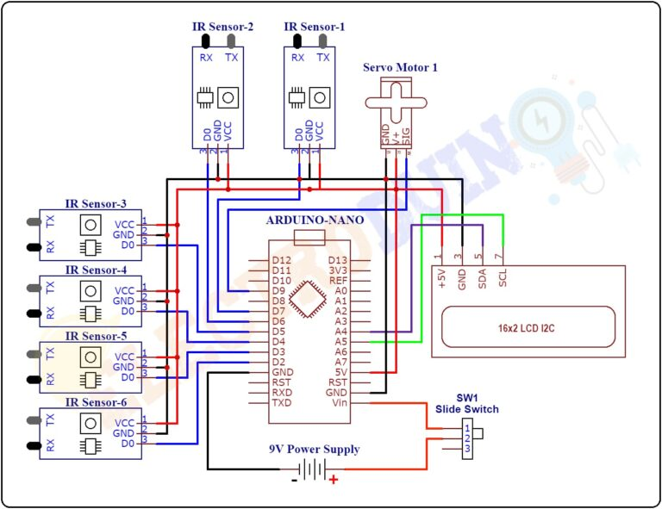
Circuit Diagram

Slide 10
Circuit Explaination
There are four parking slots in this project.IR Sensor-3, 4, 5, and 6 are placed at slot-1, 2, 3, and 4 respectively.
IR sensor-1 and 2 are placed at the entry and exit gate respectively.
A servo motor is used to operate the common single entry and exit gate.
The LCD display is placed near the entry gate.
The system used IR sensor-3, 4, 5, and 6 to detect whether the parking slot is empty or not and IR sensor-1, and 2 for detecting vehicles arriving or not at the gate.

Slide 11
Continue...
In the beginning, when all parking slots are empty, then the LCD display shows all slots are empty.
When a vehicle arrives at the gate of the parking area then the IR sensor-1 detects the vehicle and the system allowed to enter that vehicle by opening the servo barrier.
After entering into the parking area when that vehicle occupies a slot then the LED display shows that the slot is full.
In this way, this system automatically allows 4 vehicles.

Slide 12
Continue...
In case the parking is full, the system blocked the entrance gate by closing the servo barrier. And the LED display shows that slot-1, 2, 3, and 4 all are full.
When a vehicle leaves a slot and arrives at the gate of the parking area then the IR sensor-2 detects that vehicle and the system open the servo barrier.
Then the LED display shows that the slot is empty. Again the system will allow entering a new vehicle.
In this way, parking lot can be managed.

Slide 13
Advantages
Consumption of Less Fuel
Cost and Time efficient
Reduced Search Traffic
Enhanced User Experience

Slide 14
Conclusion
The services provided by smart parking have become the essence of building smart cities. The proposed system has several advantages, including detecting parking spaces using the Internet of Things. The system benefits from avoiding wasting time and reducing pollution and fuel consumption.

Slide 15
Thank You

